Slide 1
Kubernetes for the Legacy Warrior Matt Richards

Slide 2
Matt Richards
Staff Engineer at Infinite Campus
INTERESTS
Software Architecture
Front-End Development
API Development
Containers
Kubernetes

Slide 3
Infinite Campus
Mid-sized Educational Technology Company
Serves K12 School Districts in the US
8.5 Million Students
In Business for 26 years

Slide 4
The Future!!!

Slide 5
STOP!!!!

Slide 6
“I don’t work at Netflix. I’m not designing highly elastic systems for hundreds of millions of concurrent users.”
“Why Should I Care???”

Slide 7
Service-Based Architecture
1

Slide 8
Let’s pretend you work for a mid-sized educational technology company
Your product helps teachers manage their grade book
It also will calculate student’s grades throughout the year
It will also send out notifications to parents as assignments are scored

Slide 9
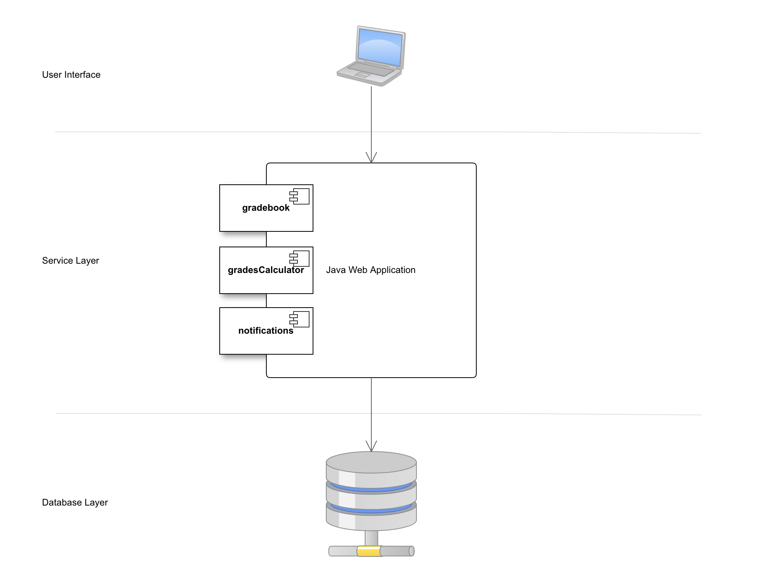
How Might This Look?

Slide 10
Let’s Look At Code!
Notes:
Show the new app.js’s
Talk about message queing

Slide 11
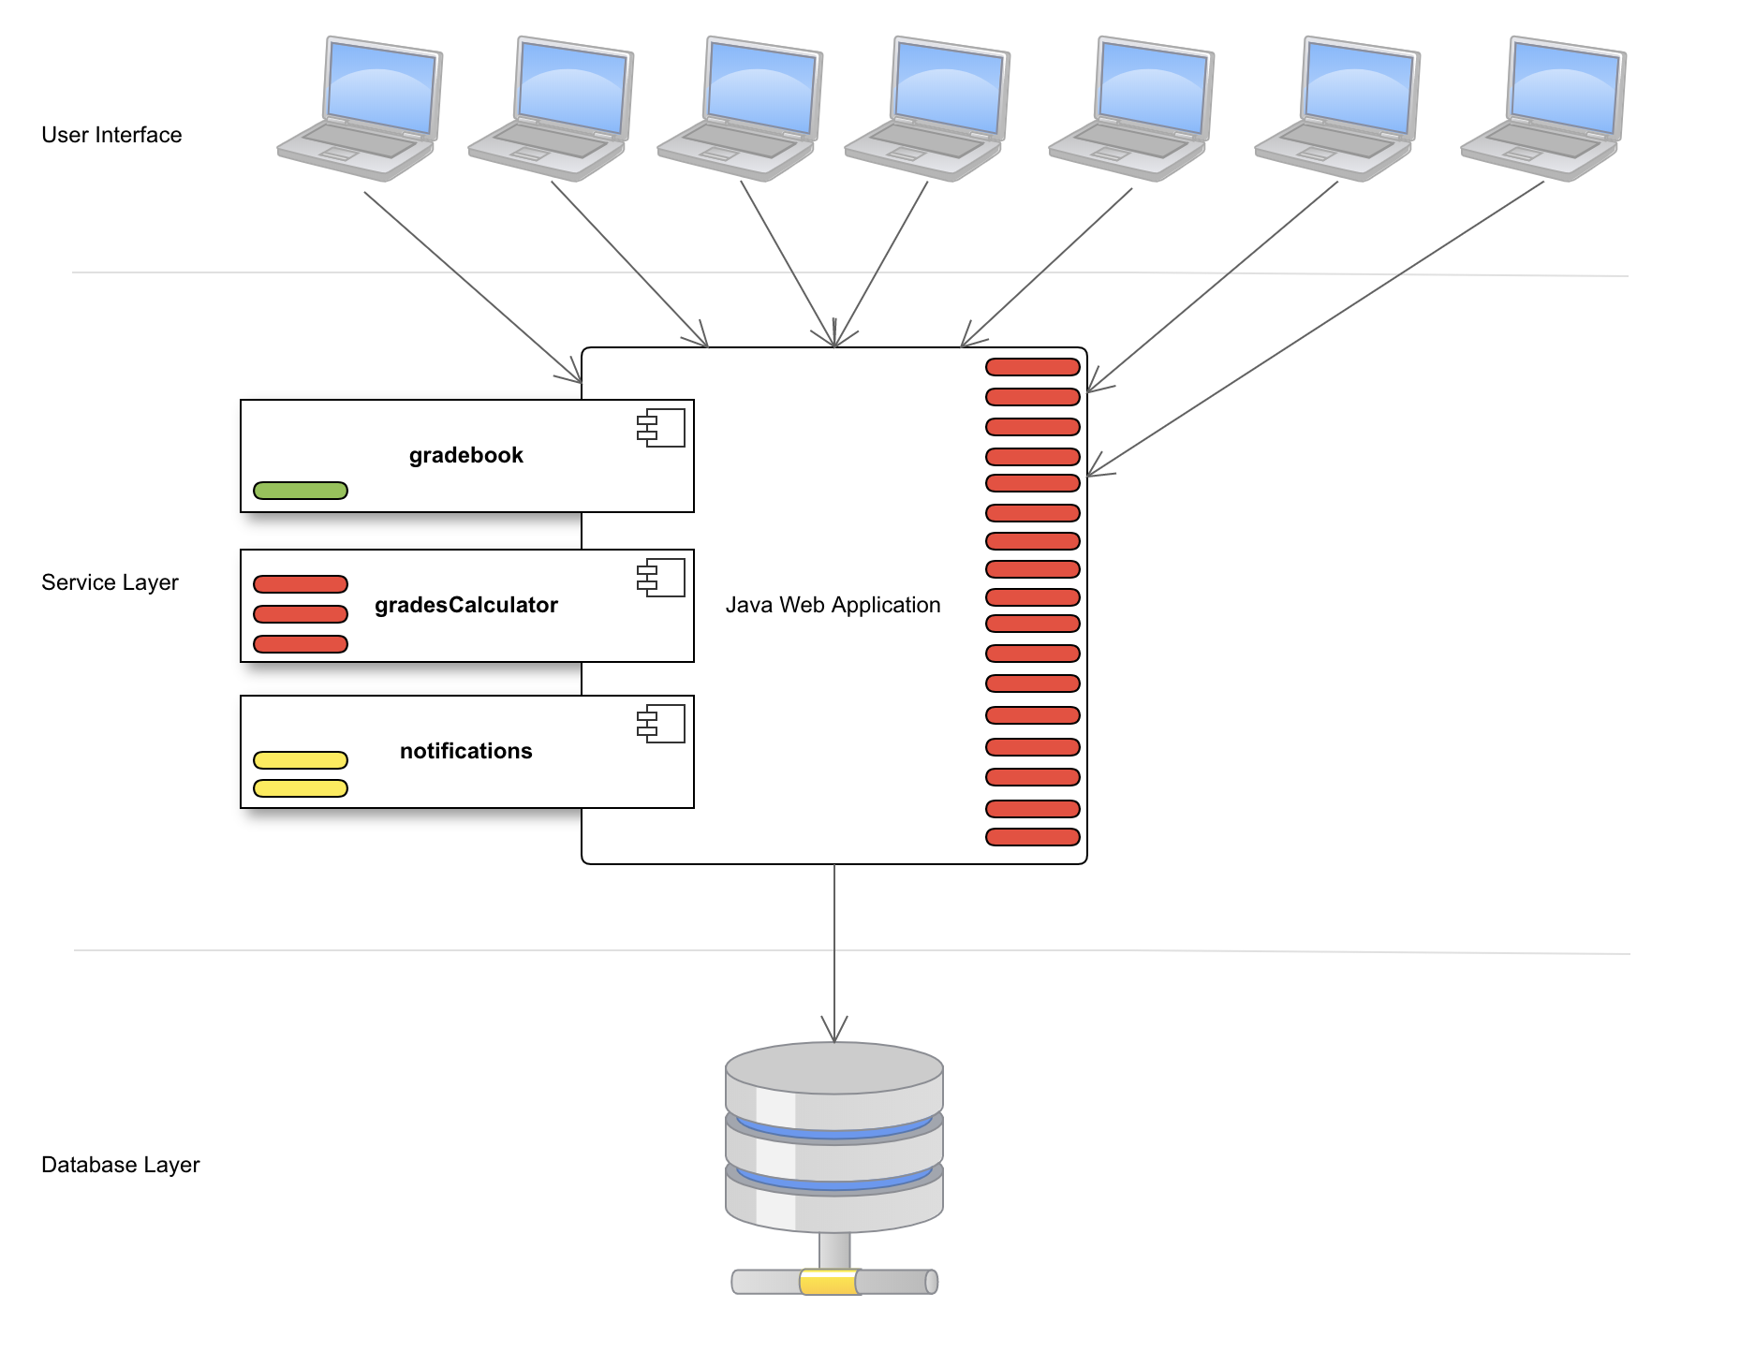
Uh oh – that’s a lot of teachers at once

Slide 12
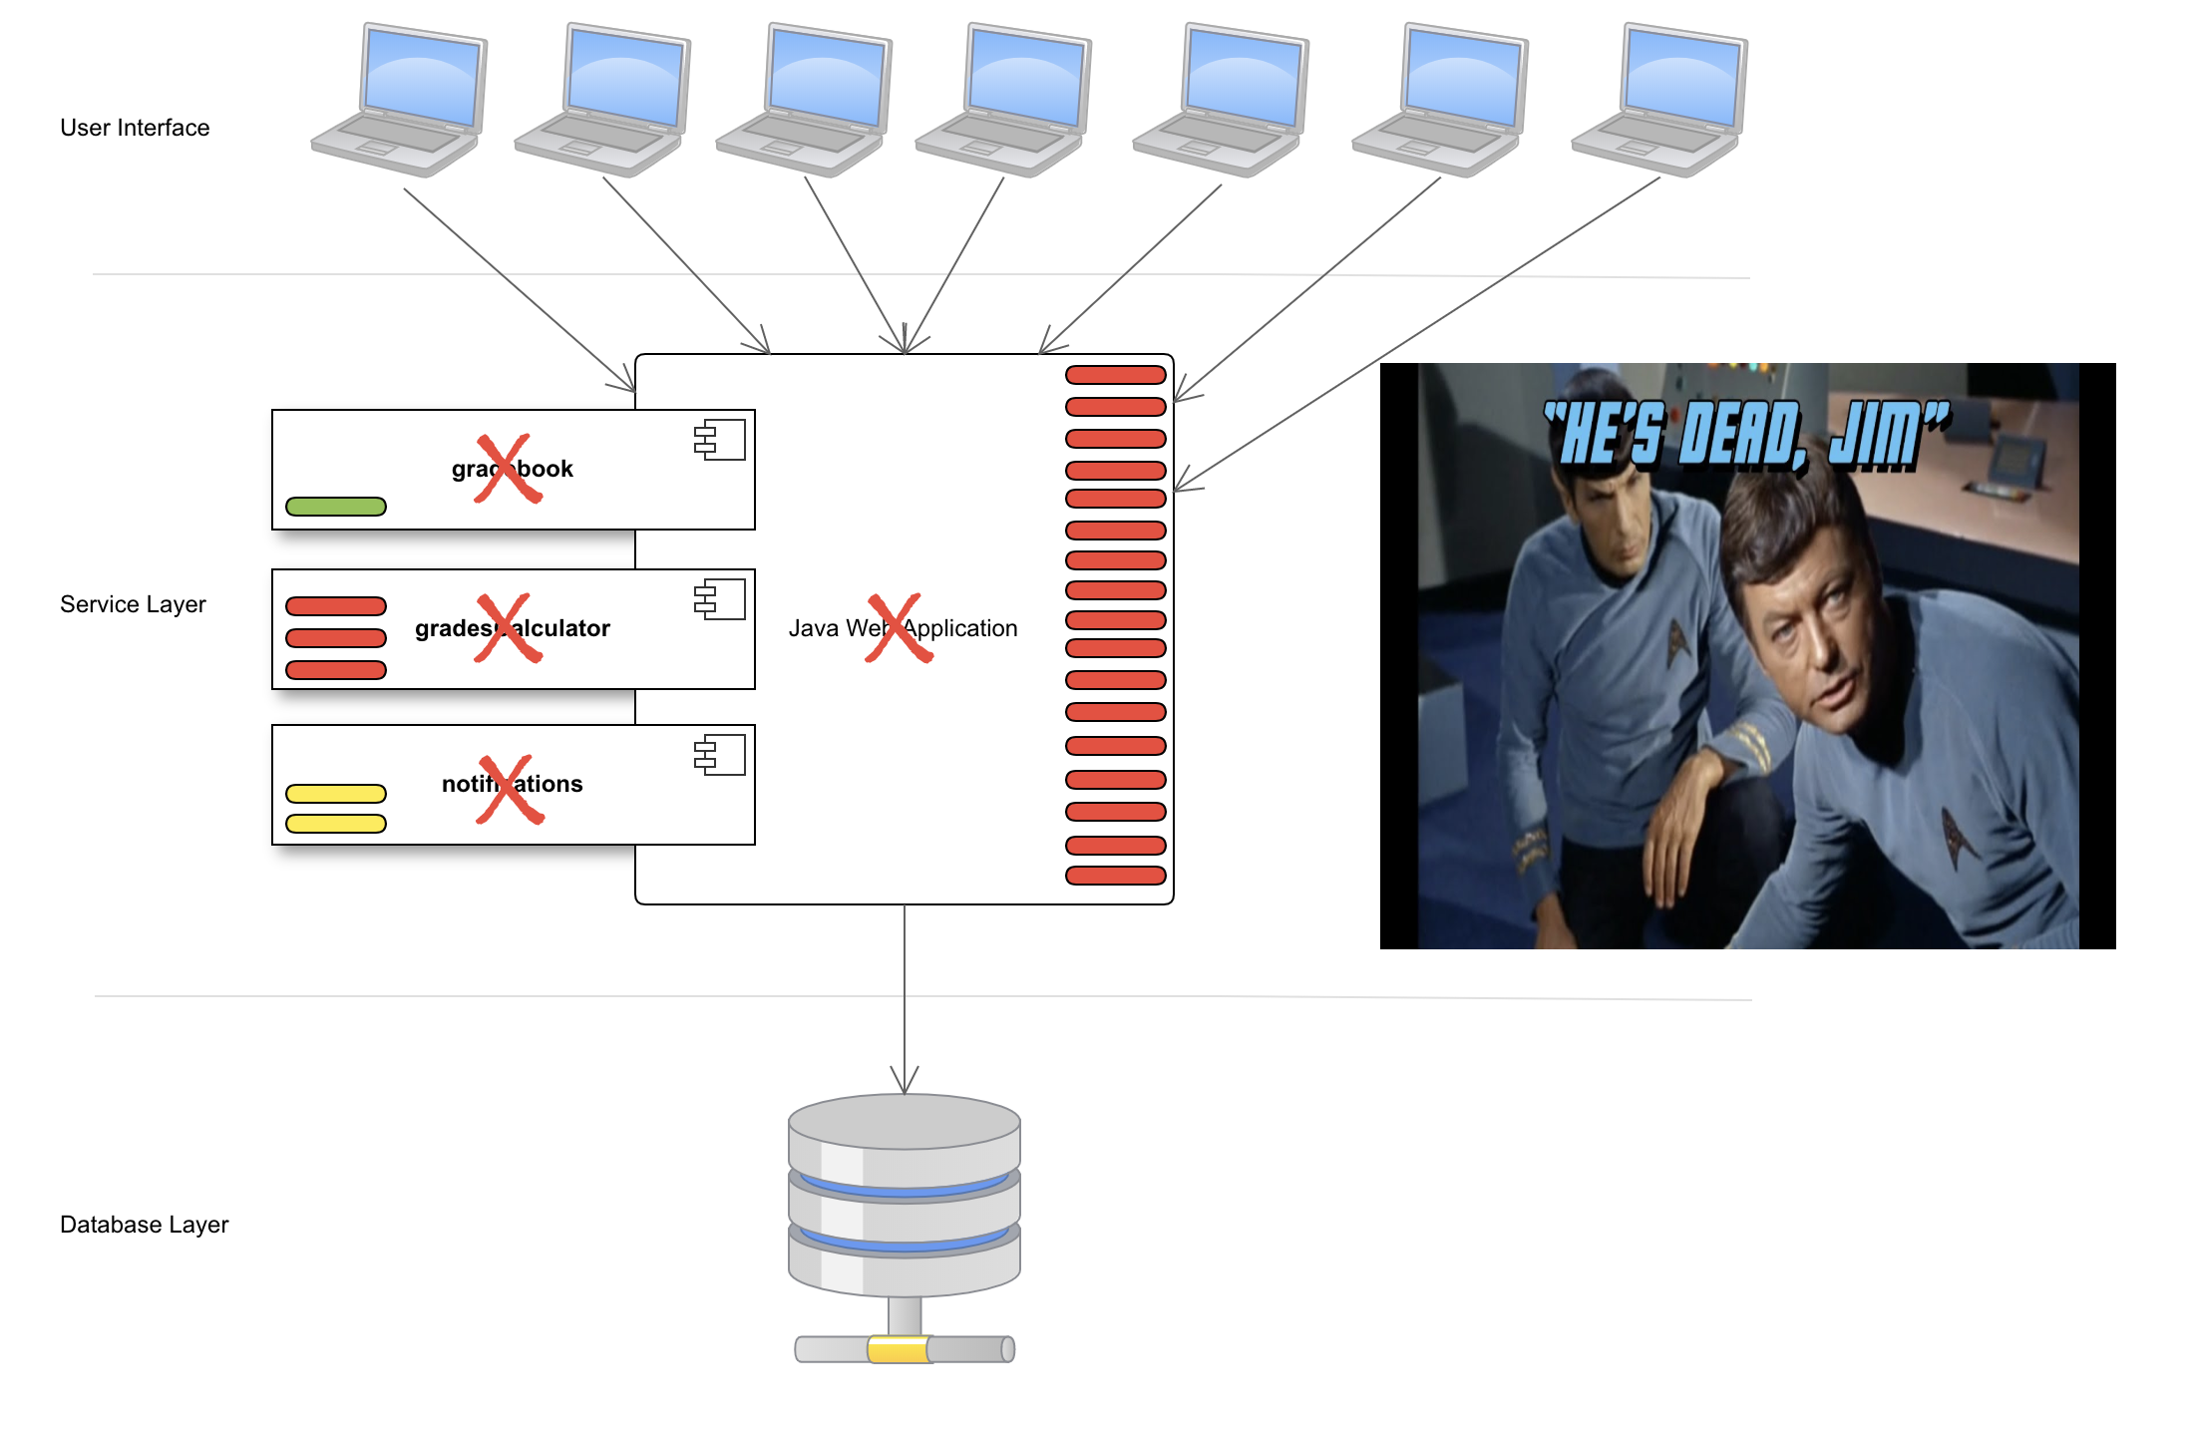
Ouch
Notes:
Kablooey. How can we prevent this? Through service based architecture. “Service-oriented architecture (SOA) is a style of software design where services are provided to the other components by application components, through a communication protocol over a network”

Slide 13
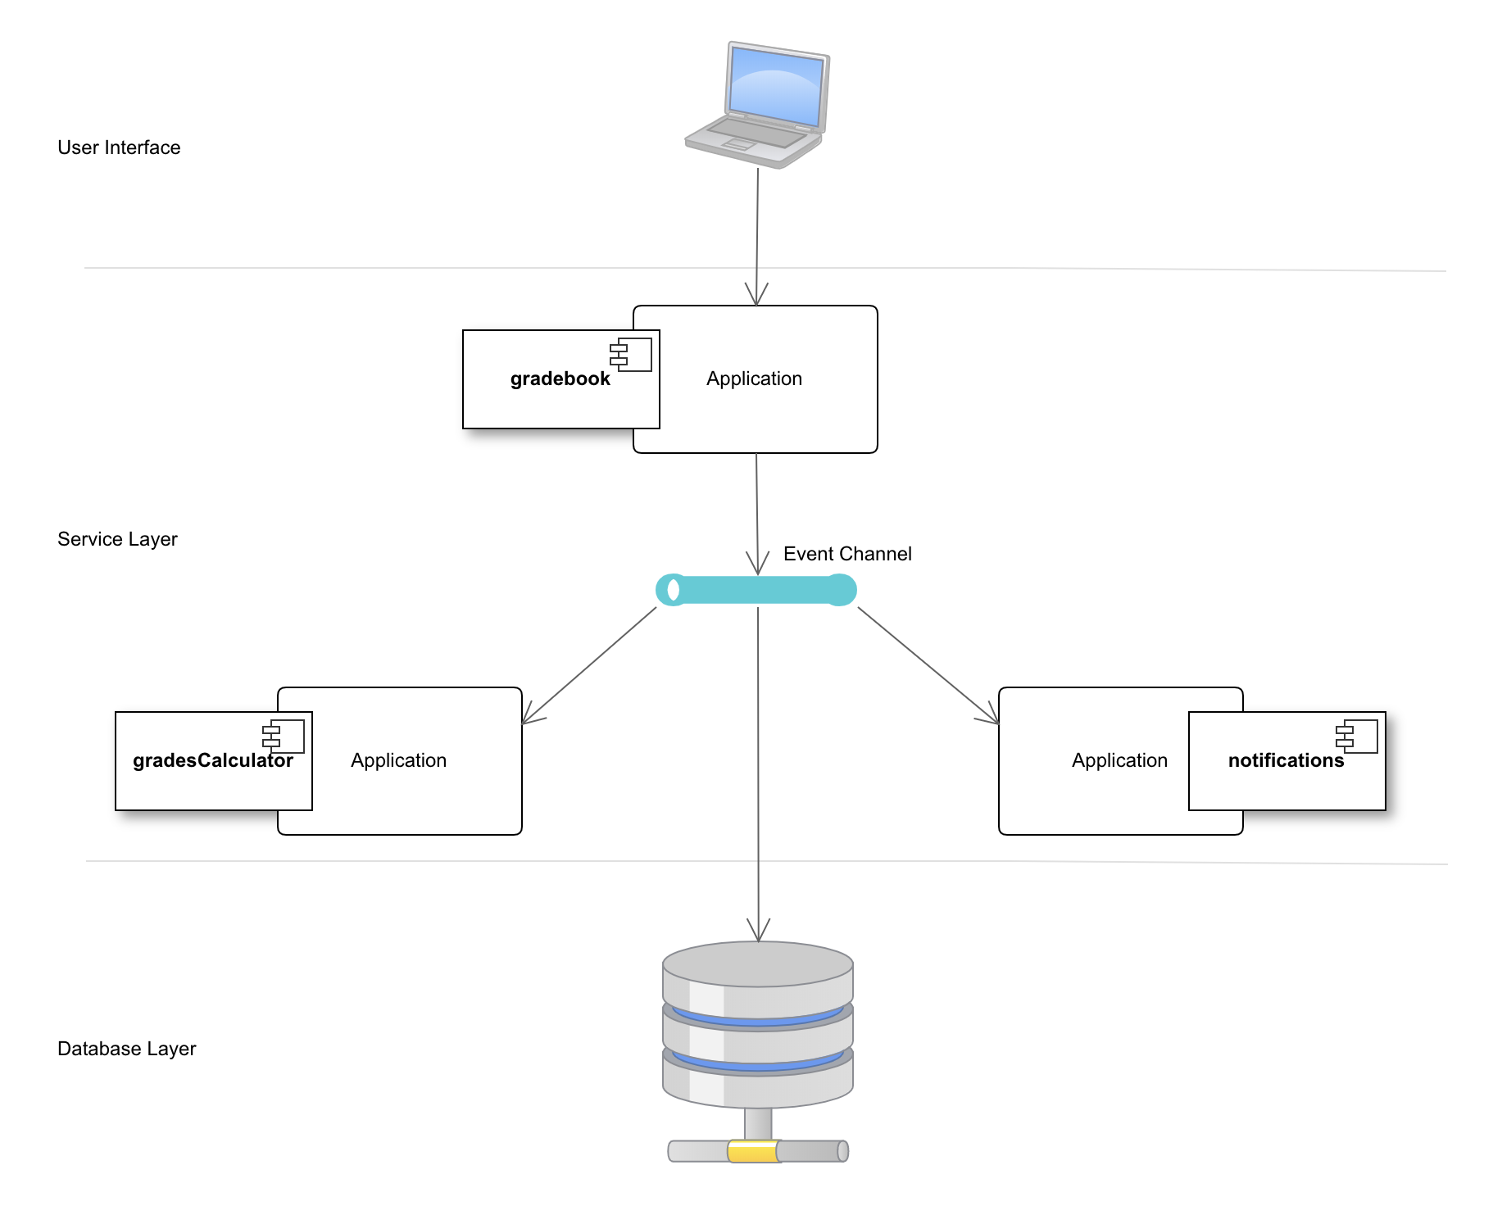
Service-Based and Decoupled
Notes:
This will keep each service protected from other service’s outages
This will make each service independently scalable
It greatly reduces customer wait time in the UI

Slide 14
Let’s Look At Code!
Notes:
Show the new app.js’s
Talk about message queing

Slide 15
Deployments are Hard

Slide 16
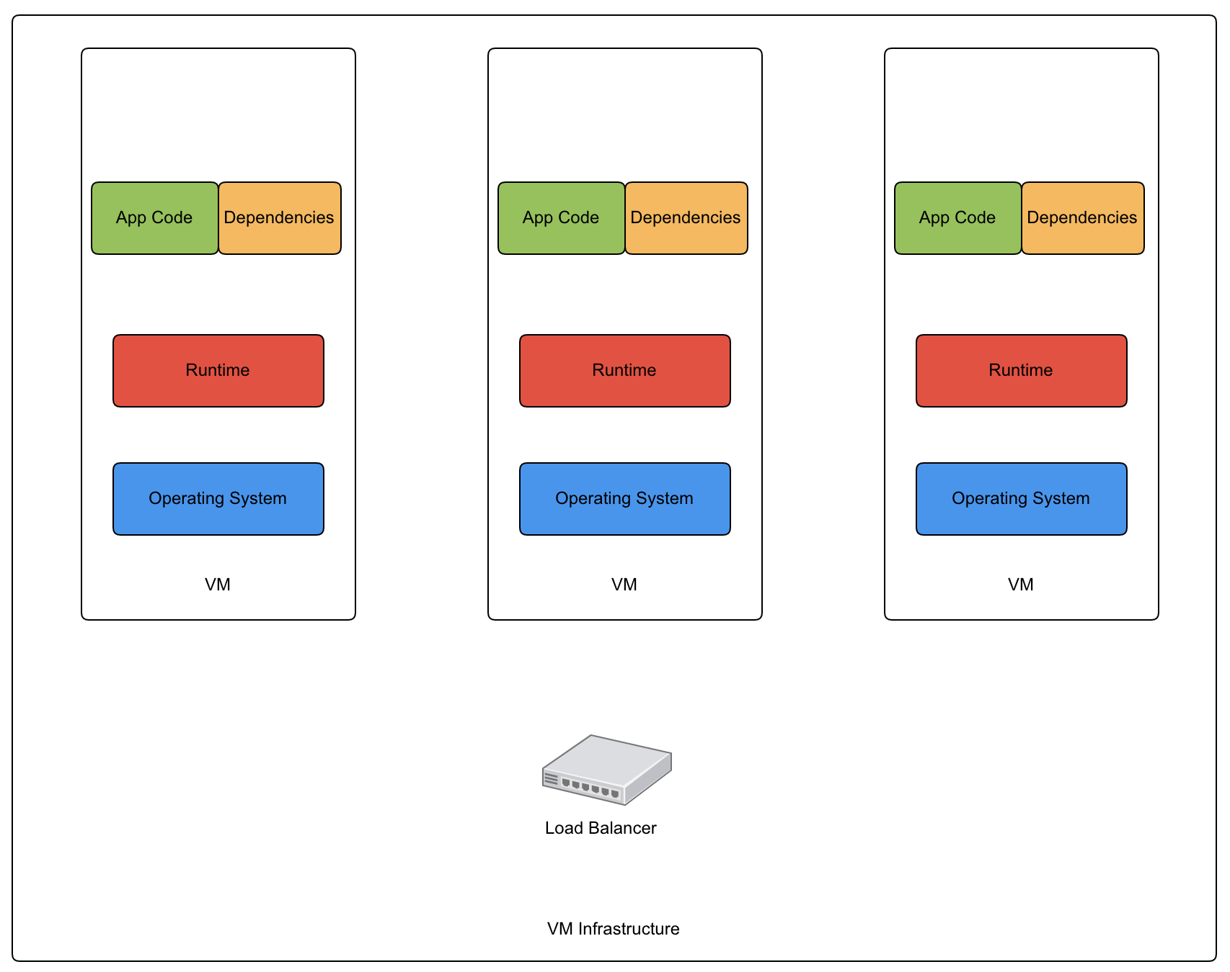

Slide 17
Containers
2

Slide 18
”A Standard Unit of Software”
https://www.docker.com/resources/what-container
Notes:
packages up code and all its dependencies so the application runs reliably and repeatably from one computing environment to another. Most common is Docker, though there are alternatives.

Slide 19
Notes:
App A may be a Java app running on a JVM on top of Ubuntu. App B may be a NodeJS API running on Alpine Linux
Or A may be our gradebook service, B and C may our grades calculator, D and E may be the notifications service, and F is our message queue

Slide 20
Let’s Look At Code!
Notes:
Show the new app.js’s
Talk about message queing

Slide 21
Orchestration (Kubernetes)
3
Notes:
The coordination of the deployment of these services, which are being run by containers, is referred to as Container Orchestration. There are several ways the industry has come up with to solve container orchestration. The by-far industry leader is Kubernetes

Slide 22
Greek for “Governor”, “Helmsman”, or “Captain”
Notes:
Created by Google – evolution of their Borg system

Slide 23
Container Deployment Automation and Coordination
Declarative Deployment Files
Self-Healing
Massively Scalable
Tutors your kids
Does your taxes

Slide 24
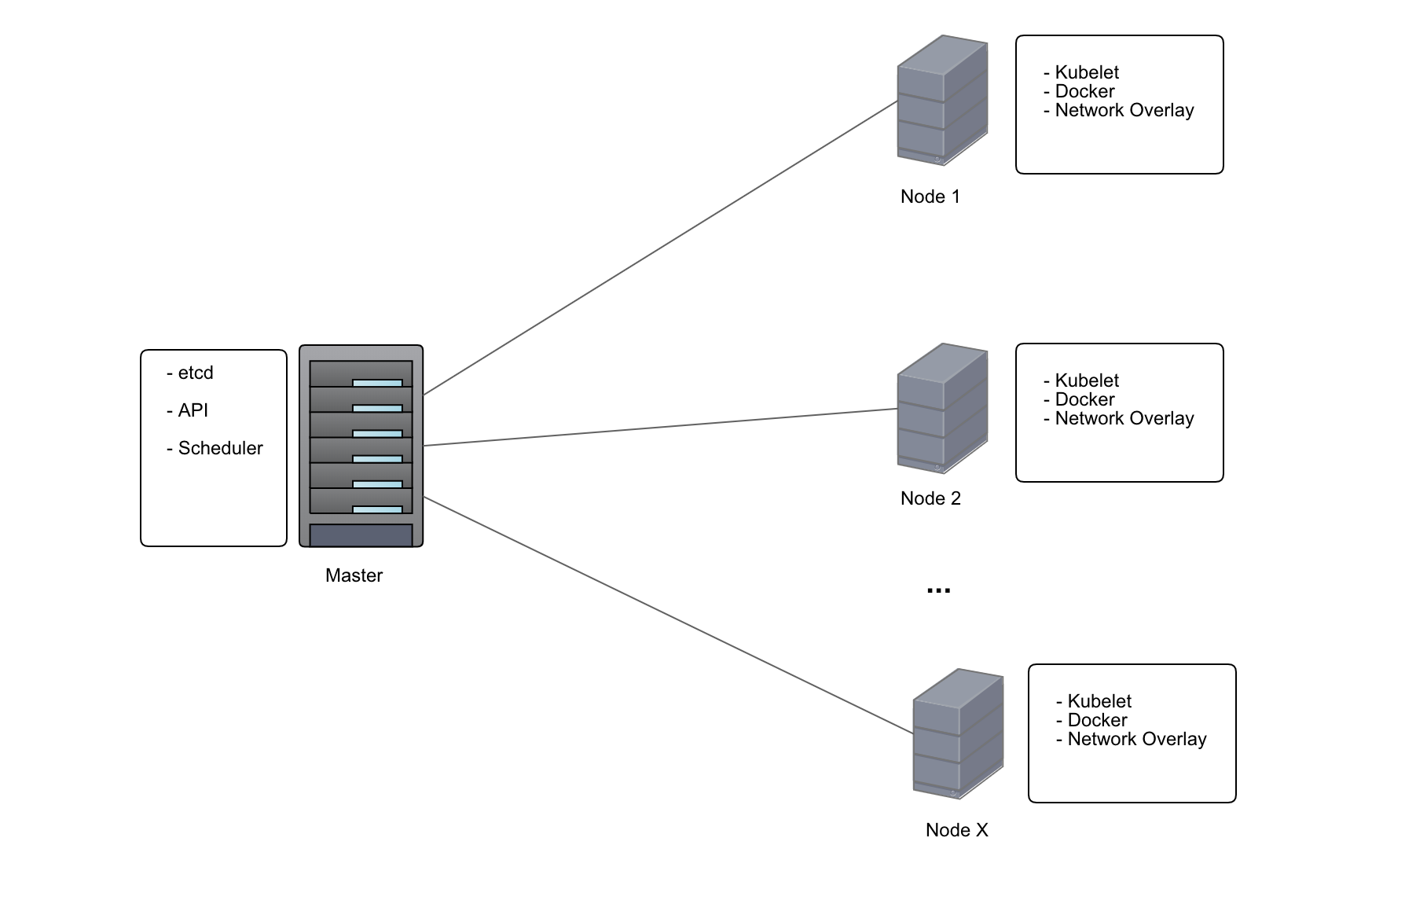

Slide 25
Let’s Look At Code!
Notes:
Show the new app.js’s
Talk about message queing

Slide 26
To Summarize
Service-Oriented Architecture combined with Message Queuing allows for decoupled components
Containers make it much easier to package and deploy individual services
Kubernetes makes for a reliable way to describe your deployments as a set of related containers

Slide 28
THANKS!
Any questions?
You can find me at
cepster.github.io
matt.richards@infinitecampus.com
Twitter @cepster

Slide 29
CREDITS
Special thanks to all the people who made and released these awesome resources for free:
Presentation template by SlidesCarnival
Icons/Logos courtesy of cncf.io

